Slide 1
IoT a viewpoint from OIC experience
JinHyeock Choi
jinchoe@samsung.com

Slide 2
contents
Overview
Main technical challenges
OIC architecture
OIC functional block diagram
OIC framework
OIC resource model
Resource, URI, Link
Property, Resource Type, OIC Device

Slide 3
Overview

Slide 4
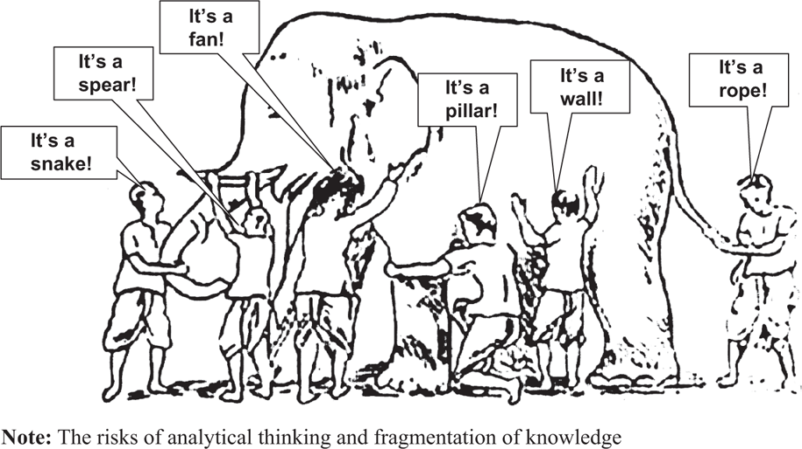
Internet of Things ?
Ubiquitous Computing
Real World Internet
Web of Thing
M2M
Cyper Physical System
Internet of Everything

Slide 5


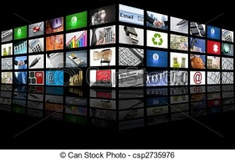


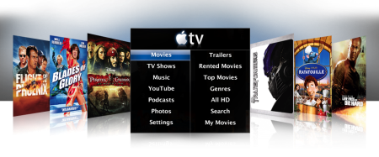


Internet
Cyber World
Digital
Cyber World open to Human
Human
User

Slide 6
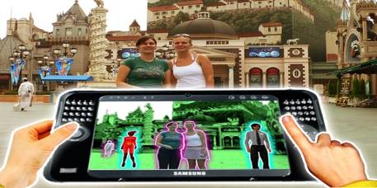


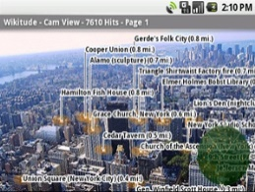
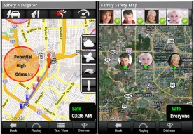
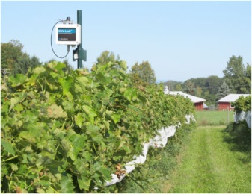
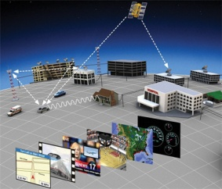
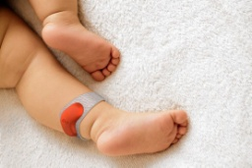
Internet of Things (IoT)
Cyber & Physical World integrated & open to Human
Cyber World
Digital
Cyber World open to Human
Physical World
Physical
Human
User

Slide 7
Challenges

Slide 8
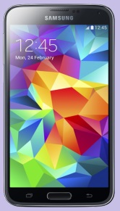
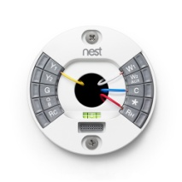
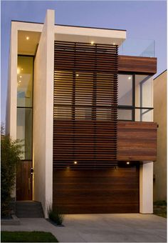

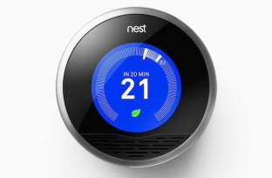
RESTful Architecture Style
Entity handler
Client
Server
Physical entity
REST Architecture Style
Request
{
"n": "myRoomTemperature",
"rt": "oic.r.temperature",
"if": "oic.if.a",
"id": "example_id_xyz",
"temperature": 23,
"units": "C",
"setValue": 25
}
Addressable resources
A uniform, constrained interface
Representation based manipulation
Communicate statelessly
Hypermedia State Engine
Response
CRUD & N operation
Resource (representation)
Resource (representation)
RESTful Architecture (Representational State Transfer)
Resource based operation
Real world ‘entity’ is represented as ‘Resource’
Resource manipulation via Request/ Response: CRUDN

Slide 9
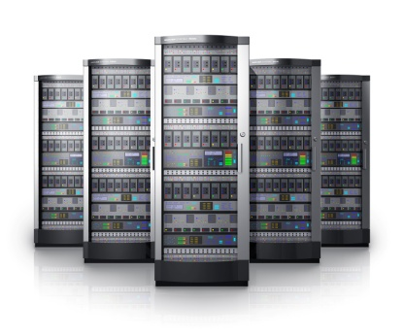
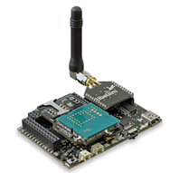

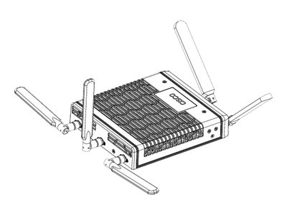

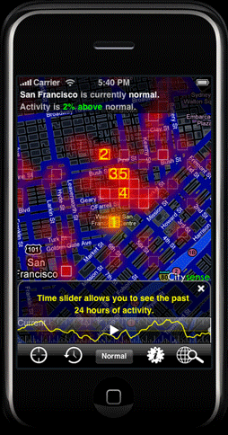

(conceptual) IoT Architecture & Procedures
Service Server
Actuator
Gateway
Sensor
User
Device
Sensor
Actuator

Slide 10
(conceptual) IoT Architecture & Procedures
Monitoring with sensors
0. Event occurrence
1. Request sensor for data
2. Response with data
Service Server
Actuator
Gateway
Sensor
User
Device
Sensor
Actuator

Slide 11
(conceptual) IoT Architecture & Procedures
Monitoring with sensors
0. Event occurrence
1. Request sensor for data
2. Response with data
3. Notify without Request
Service Server
Actuator
Gateway
Sensor
User
Device
Sensor
Actuator

Slide 12
(conceptual) IoT Architecture & Procedures
Controlling with actuators
0. Event occurrence
1. Request actuators for state transfer
2. Actuator action
3. Response with state information
Service Server
Actuator
Gateway
Sensor
User
Device
Sensor
Actuator

Slide 13
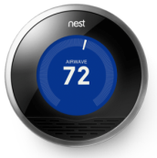
(Example) NEST Operations with Protocols
Monitoring with NEST thermostat (by Smartphone)
NEST
Service Server
Gateway
Smart Phone
NEST Thermostat
(Sensor & Actuator)

Slide 14


(Example) NEST Operations with Protocols
Monitoring with NEST thermostat (by Smartphone)
0. Event occurrence
1. Request NEST for temperature
1.1. data format with JSON
1.2. message & method with HTTP GET
1.3. delivery with TCP/IP
NEST
Service Server
1.4. over the air with WiFi
Gateway
Smart Phone
NEST Thermostat
(Sensor & Actuator)

Slide 15
(Example) NEST Operations with Protocols
Monitoring with NEST thermostat (by Smartphone)
0. Event occurrence
1. Request NEST for temperature
1.1. data format with JSON
1.2. message & method with HTTP GET
1.3. delivery with TCP/IP
NEST
Service Server
1.4. over the air with WiFi
2. Response with temperature
Gateway
Smart Phone
Simplified & further procedures needed
NEST Thermostat
(Sensor & Actuator)
service discovery & ID resolution
lightweight network protocol
access control & security
et cetra…

Slide 16
(Example) NEST Operations with Protocols
Controlling with NEST thermostat (by NEST Service Server)
0. Event occurrence
NEST
Service Server
Gateway
Smart Phone
NEST Thermostat
(Sensor & Actuator)

Slide 17
(Example) NEST Operations with Protocols
Controlling with NEST thermostat (by NEST Service Server)
0. Event occurrence
1. Request NEST for temperature change
1.1. data format with JSON
1.2. message & method with HTTP PUT
1.3. delivery with TCP/IP
NEST
Service Server
1.4. over the air with WiFi
2. Change temperature with HVAC
Gateway
Smart Phone
NEST Thermostat
(Sensor & Actuator)

Slide 18
(Example) NEST Operations with Protocols
Controlling with NEST thermostat (by NEST Service Server)
0. Event occurrence
1. Request NEST for temperature change
1.1. data format with JSON
1.2. message & method with HTTP PUT
1.3. delivery with TCP/IP
NEST
Service Server
1.4. over the air with WiFi
2. Change temperature with HVAC
3. Response with state info
Gateway
Smart Phone
Simplified & further procedures needed
NEST Thermostat
(Sensor & Actuator)
service discovery & ID resolution
lightweight network protocol
access control & security
et cetra…

Slide 19
(conceptual) IoT Architecture & Procedures
Controlling & Monitoring
with sensor & actuator
Service Server
Actuator
Gateway
Sensor
User
Device
Sensor
Actuator

Slide 20
Main IoT Technologies
Service Server
Actuator
Gateway
Sensor
User
Device
Sensor
Actuator

Slide 21
Main IoT Technical Challenges
Networked Embedded Device
Service Server
Actuator
Gateway
Sensor
User
Device
Sensor
Actuator

Slide 22
Main IoT Technical Challenges
Networked Embedded Device
Service Server
Actuator
Gateway
Sensor
User
Device
Connectivity
Sensor
Actuator

Slide 23
Main IoT Technical Challenges
IoT Network
Networked Embedded Device
Service Server
Actuator
Gateway
Sensor
User
Device
Connectivity 기술
Sensor
Actuator

Slide 24
Main IoT Technical Challenges
IoT Network
Networked Embedded Device
Service Server
Actuator
Gateway
IoT Core Framework
Sensor
User
Device
Connectivity
Sensor
Actuator

Slide 25
Main IoT Technical Challenges
Big Data Analysis
IoT Network
Networked Embedded Device
Service Server
Actuator
Gateway
IoT Core Framework
Sensor
User
Device
Connectivity
Sensor
Actuator

Slide 26
Main IoT Technical Challenges
Big Data Analysis
IoT Network
Networked Embedded Device
Service Server
Actuator
UX
Gateway
IoT Core Framework
Sensor
User
Device
Connectivity
Sensor
Actuator

Slide 27
Main IoT Technical Challenges
IoT Standard
Big Data Analysis
IoT Network
Networked Embedded Device
Service Server
Actuator
UX
Gateway
IoT Core Framework
Sensor
User
Device
Connectivity
IoT Security
Sensor
Actuator

Slide 28
Main IoT Technical Challenges vs Internet
IoT Standard
Big Data Analysis
IETF & W3C & IEEE & 3GPP
IoT Network
Search (?)
TCP/ IP
Networked Embedded Device
Web server
Service Server
Actuator
UX
Web Browser
Gateway
IoT Core Framework
Sensor
WWW
User
Device
Connectivity
LAN, WLAN
IoT Security 기술
Sensor
IPSec, DES
Actuator

Slide 29

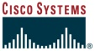





Main IoT Technical Challenges vs Internet
IoT Standard
Big Data Analysis
IETF & W3C & IEEE & 3GPP
IoT Network
Search (?)
TCP/ IP
Google
Cisco
Networked Embedded Device
Web server
SUN
Service Server
Actuator
UX
Web Browser
Gateway
Apple
IoT Core Framework
Sensor
WWW
User
Device
Connectivity
NETSCAPE
LAN, WLAN
3Com
IoT Security 기술
Sensor
IPSec, DES
RSA
Actuator

Slide 30
OIC architecture

Slide 31
RESTful Architecture Style
Entity handler
Client
Server
Physical entity
REST Architecture Style
Request
{
"n": "myRoomTemperature",
"rt": "oic.r.temperature",
"if": "oic.if.a",
"id": "example_id_xyz",
"temperature": 23,
"units": "C",
"setValue": 25
}
Addressable resources
A uniform, constrained interface
Representation based manipulation
Communicate statelessly
Hypermedia State Engine
Response
CRUD & N operation
Resource (representation)
Resource (representation)
RESTful Architecture (Representational State Transfer)
Resource based operation
Real world ‘entity’ is represented as ‘Resource’
Resource manipulation via Request/ Response: CRUDN

Slide 32
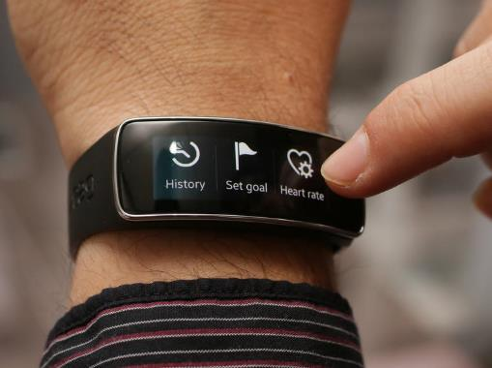


Logical organization: 3 part approach
Resource model and organization
(Declarative)
Resource model
Communication and Interoperability
(Protocol processing
& Messaging)
Device abstraction (entity handler)
(Imperative)
RESTful transaction
Abstraction
Resource Model
Device:
“Wrist Band”
GET
URI: /s/hm/data
CoAP
Resource Type
Time: UT
Rate: F
Name: S
Relative URI
Request
/s/hm/data
Resource Address
Resolution: I
Range: I
Name: S
Resource
Response
Time: 11:30
Rate: 80
Name: Ravi HR
Binding
Protocol
Servlet
Fully-qualified URI
Entity Handler
OIC Client
/192.168.1.1/s/hm/mgmt
Representation
Resource Interface
Entity (e.g. HW Sensor)
RESTful transaction
OIC Server
Resource
Abstraction
[OIC Concepts & Architecture Review, Ravi Subramaniam]

Slide 33
IoT Protocol Stacks
Service Profile 1
(Connected Health)
Service Profile 2
(Connected Edu)
Service Profile 3
(Connected Car)
Service Profile 4
(Connected Retail)
Service Profile 5
(Smart City)
Service
Platform
Resource Abstract
Resource Representation
Resource Rendezvous
Resource Manipulation
URI/ ID
Meta data /Link
Attributes
Structure/ Org
Model/ JSON
Service Discovery
Virtual BUS
Sensing Acting
CRUDN
HTTP/ HTTPS
CoAP
MQTT
XMPP
DDS
SIP
DNS
SSDP
TCP
UDP
SCTP
RTP
MPTCP
ICMP
Delay Tolerant Transport
6light
homenet
RPL
Ad-hoc VANET
Geo-Networking
Proxy/ Gateway
MIB
eman
Energy Efficient Protocol
Network
IPv6
Access Control
AAA
EAP
DIAMETER
SSL/TLS
RFC 4861
RFC 4862
6loWPAN
6tisch
6lo
16ng
RFC 6459
ETSI TS102859
IP over Foo (PLC, VLC)
Physical
IEEE 802.3 Ethernet
IEEE 802.11 WiFi
IEEE 802.15.1 Bluetooth
IEEE 802.15.4 Zigbee
IEEE 802.15.7 VLC
IEEE 1901.2 PLC
IEEE 802.11 p C2C-CC
IEEE 802.16 WiMAX
Cellular 3GPP LTE
DMC R&D Center ⓒ 2013 SAMSUNG Electronics Co.

Slide 34

Internet & IoT layer comparison
Internet
IoT
email, web, phone...
WWW, HTTP, URL
TCP UDP
IP
ND, ARP…
Ethernet, sonet...
copper fiber radio...
sensing, acting
OIC, oneM2M, CoAP
DTN
v6
6LowPAN…
WiFi, BLE, VANET...
fiber, radio, light...
Service layer
Network
[from Internet Hourglass model by Steve Deering]

Slide 35
(background) Service layer – oneM2M
oneM2M Layered Model
Common Services Functions
[From TS0001 Functional Architecture, oneM2M]

Slide 36
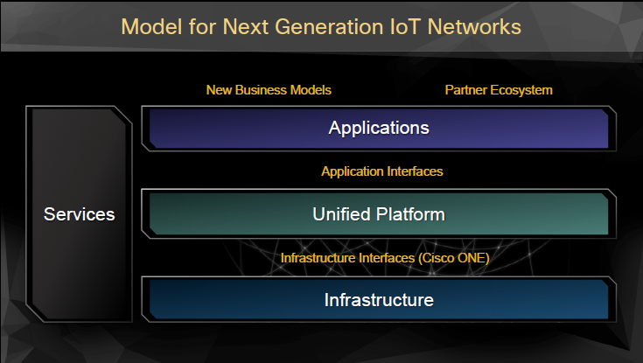
(background) Service layer – oneM2M
[Cisco presentation at IoT World Forum 2013]

Slide 37
(background) oneM2M & Cisco comparison
Service layer
Network
oneM2M Layered Model

Slide 38
OIC Functional Block Diagram
OIC Framework
Application profiles
Smart Home
Connected Health
Retail
Automotive
ID & Addressing
Resource model
CRUDN
Security
Discovery
Messaging
Streaming
Device management
Group management
Protocol bridge/ Gateway
Transport
Networking
L2 Connectivity

Slide 39
OIC Framework – IoT Platform(?)
OIC Framework
Application profiles
Smart Home
Connected Health
Retail
Automotive
ID & Addressing
Resource model
CRUDN
Security
Discovery
Messaging
Streaming
Device management
Group management
Protocol bridge/ Gateway
Transport
Networking
L2 Connectivity

Slide 40
OIC Framework – IoT Platform(?)
OIC Framework
ID & Addressing
Resource model
CRUDN
Security
ID & Address
Identifier & locator with resolution scheme
Resource management
Define resource & management
Create, Retrieve, Update, Delete & Notification of Resource
Security
Authentication, & Access control & Encryption
Discovery
Messaging
Streaming
Discovery
Finding relevant device & service information
Messaging
Transfer a message with control method
Streaming
Deliver data flow with QoS constraints
Device management
Group management
Protocol bridge/ Gateway
Device management
Manage device capability
Group management
Manage group & collective group activity
Protocol bridge
Intermediate or translate between different protocols

Slide 41

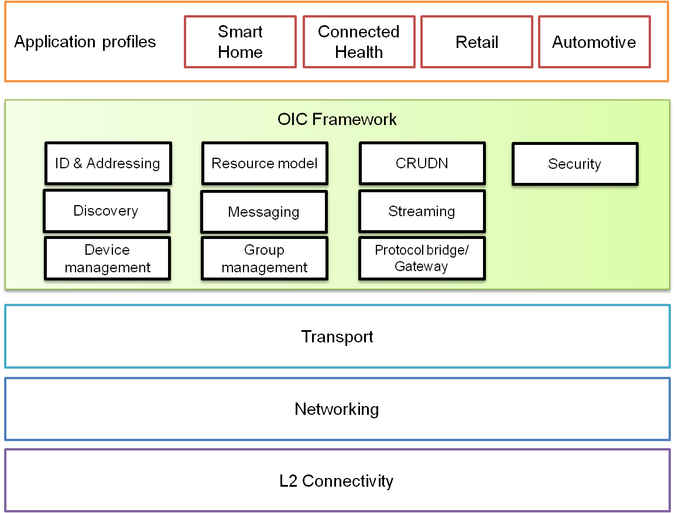







OIC Framework – IoT Platform(?)
Smart Object
mDNS, DNS-SD
oneM2M TS0001, ooo4
CoAP, http
URI, UUID, IPv6
IBE, DTLS/TLS
TCP, UDP, DTN
IPv6, 6lo, geonet
Homenet, Anima
XMPP, MQTT
BT/ BLE, 802.15.4, 802.11p

Slide 42
OIC Framework – IoT Platform(?)
Smart Object
mDNS, DNS-SD
oneM2M TS0001, ooo4
CoAP, http
URI, UUID, IPv6
IBE, DTLS/TLS
TCP, UDP, DTN
IPv6, 6lo, geonet
Homenet, Anima
XMPP, MQTT
BT/ BLE, 802.15.4, 802.11p

Slide 43
OIC specification summary
Spec items | Summary | Issues
ID & Addressing | Entity to identify: Resource, Device, App, User? | Define entities to identify Define ID per entity Identifier format: URI (URN+URL) Present a resolution scheme
 | IDs per an entity: UUID & URI
 | ID format: UUID, URI = <host>/datapath/?
 | Resolution scheme
Resource model | Resource terms: attributes, interface… | Clarify resource terms & rules Common resource & attributes Align with existing resource standard (oneM2M)
 | Resource format
 | Common resource & attributes
CRUDN | Generic Request & Response format | Parameters for REQ & RES Generic procedure (Notification)
 | CRUDN procedures with Request & Response
Discovery | Local: mDNS, or CoAP based | Multiprotocol: mDNS vs CoAP discovery Advance remote discovery Define a registration standard Term: Search & Advertisement (?)
 | Remote: TBD
 | Registration
 | Unsolicited (Search & Advertisement)
Messaging | CoAP, HTTP, MQTT,XMPP | REST transaction with MQTT Multi-protocol: CoAP & MQTT CoAP over BT/ BLE
 | Non-IP support (CoAP over BT./BLE)
Streaming | Uni-directional streaming(?) TBD | Streaming with REST model
Device mgmt | On boarding, ii) configuration, iii) device monitoring & iv) diagnostics | OMA LWM2M? Resource model conflict?
Group mgmt | Collection with collective action | Align with open source
Protocol bridge | CoAP to Foo bridge(?) | Align with open source & ii) spec item?
Security | Provisioning, Authentication, Access Control | Align with ID & Addressing

Slide 44
(tentative) OIC protocol stack
Smart Device
APP
REST
HTTP | MQTT | XMPP | DDS | RTP | CoAP | mDNS | SSDP
TCP |  |  |  | UDP
IPv4/ IPv6
L2 Connectivity
APP Profile + (CoAP?)
GAP, GATT
SMP | ATT
L2CAP
Link Layer
BT Baseband + RF
Thin device (IP)
Thinner device (non-IP)
APP
REST
CoAP | mDNS | SSDP | MQTT
UDP
IPv4/ IPv6
L2 Connectivity
APP Profile + (CoAP?)
GAP, GATT
SMP | ATT
L2CAP
Link Layer
BT Baseband + RF

Slide 45
(tentative) OIC protocol stack
Smart Device
APP
REST
HTTP | MQTT | XMPP | DDS | RTP | CoAP | mDNS | SSDP
TCP |  |  |  | UDP
IPv4/ IPv6
L2 Connectivity
APP Profile + (CoAP?)
GAP, GATT
SMP | ATT
L2CAP
Link Layer
BT Baseband + RF
Thin device (IP)
Thinner device (non-IP)
APP
REST
CoAP | mDNS | SSDP | MQTT
UDP
IPv4/ IPv6
L2 Connectivity
APP Profile + (CoAP?)
GAP, GATT
SMP | ATT
L2CAP
Link Layer
BT Baseband + RF

Slide 46
Appendix

Slide 47
Network Architecture
“A set of principles and basic mechanisms that guide network engineering.”
Boundaries fuzzy: bounded from “above” by requirements and from “below” by engineering.
Even fuzzier: boundary between architecture and mechanism.
Historically, informal architectural ideas guided design of the Internet protocols, but the architecture was formalized later...
“The Design Philosophy of the DARPA Internet Protocols”, David D. Clark, SIGCOMM ‘88, p.106.

Slide 48



Architecture, a conceptual metaphor

Slide 49
Network Architecture
What entities are named, and how?
How do naming, addressing, and routing inter-relate?
Where & how is state installed and removed?
How are functions modularized?
How are resources allocated?
How are security boundaries drawn and enforced?

Slide 50
A brief history of Internet
1960s: the idea of packet switching
Paul Baran (RAND) & Donald Davies (NPL) & Leonard Kleinrock (MIT)
1969: Birth of the ARPANET packet-switched network.
First IMP installed at UCLA
1974: Cerf/Kahn paper on internetworking
Many elements of the final Internet protocol design
1977: ARPA research program on internetworking
Important players included: BBN, DEC, ISI, MIT, SRI, UCLA
6 prototype implementations of TCP/IP
Jan 1, 1983: Birth of the Internet
ARPAnet switched to TCP/IP protocols; Mil Std.
~1991: World-Wide Web introduced
From academic tool to popular culture

Slide 51
phone system
The Phone System is not about phones, it’s about dynamically constructing a path from caller to callee, connecting wires to other wires.
Data can’t flow until a path is set up so efficiency decreases when setup time or holding time decreases, not suitable for computer network with “bursty” nature.

Slide 52
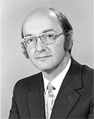
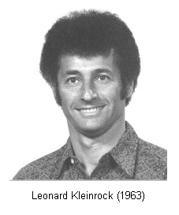
packet switching
Change viewpoint to focus on endpoints rather than paths.
Data sent in independent chunks and each chunk contains the name of the final destination.
(Transitivity) If node gets a chunk for a different destination, forward it to the next hop.
In 1964 these ideas were ‘lunatic fringe’ - anyone who knew anything about communications knew this could never work.
Paul Baran & Donald Davies & Leonard Kleinrock

Slide 53


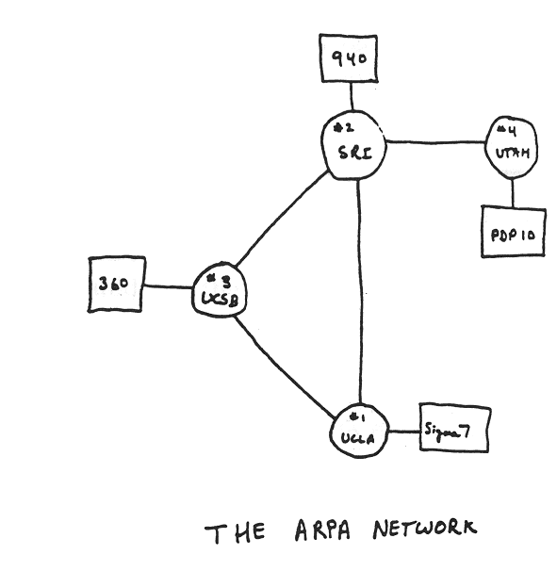
ARPANET
Bob Taylor had an idea of connecting computers (1966)
“Computer as a Communication Device” with J.P. Licklider (1968)
Larry Roberts led ARPANET project with packet switching idea
Wes Clark put forth an idea of ‘Router’
BBN built an IMP with Honeywell computer
First IMP installed at UCLA (1969)
Bob Taylor & Larry Roberts
No host-to-host protocol
NWG (Network Working Group)
The birth of IETF & RFC
NCP (Network Control Protocol)
Host-to-host protocol 1970
Remote log-in & file transfer

Slide 54
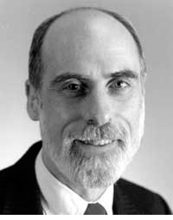
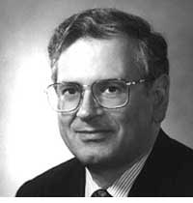
TCP/ IP
Packet switching worked so well that by 1973 there appeared multiple networks.
Each was done as a clean slate so they didn't interoperate.
Needs a network of networks
Vint Cerf & Bob Kahn realized that a common encapsulation & addressing structure could glue together arbitrary networks.
First demo in 77 & ARPANET switches to TCP/ IP from NCP in 83
Vint Cerf & Bob Kahn in 70s

Slide 55
Top level goals
develop an effective technique for multiplexed utilization of existing interconnected networks.
Network (subnets): components which were to be interconnected to provide some larger service.
originally aim to connect ARPANET with ARPA packet radio network.
An alternative(?): design a unified system which incorporated a variety of different transmission media, a multi-media network.

Slide 56
Thin waist
A universal internetworking protocol IP forms a “common bearer service” end-to-end.
a single internet protocol to maximize interoperability & minimize number of service interfaces
a narrow internet protocol to assume least common network functionality to maximize number of usable networks

Slide 57
Some changes
Internet was invented in this word for resource sharing. Since then many changes occurred.
New devices: PC, cellular, machine & sensor
New technology: wireless & optical
New applications: multimedia, real-time, p2p, emergency
New requirements: mobility, robustness & security

